Slide 1
Artificial Intelligence Lecture 10

Slide 2
Contents
CNN architectures
LeNet-5
AlexNet
ZFNet
VGG
GoogleNet
ResNet
Data augmentation

Slide 3
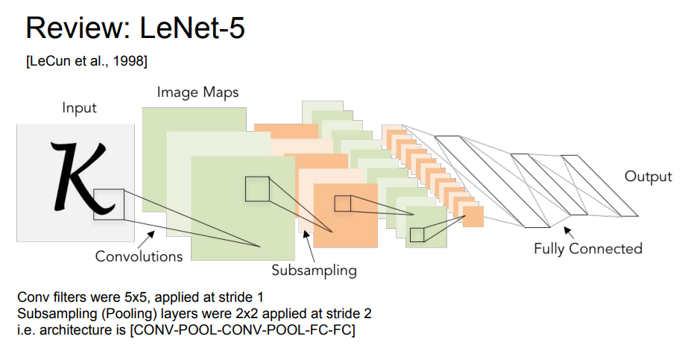
CNN Architectures

Slide 4
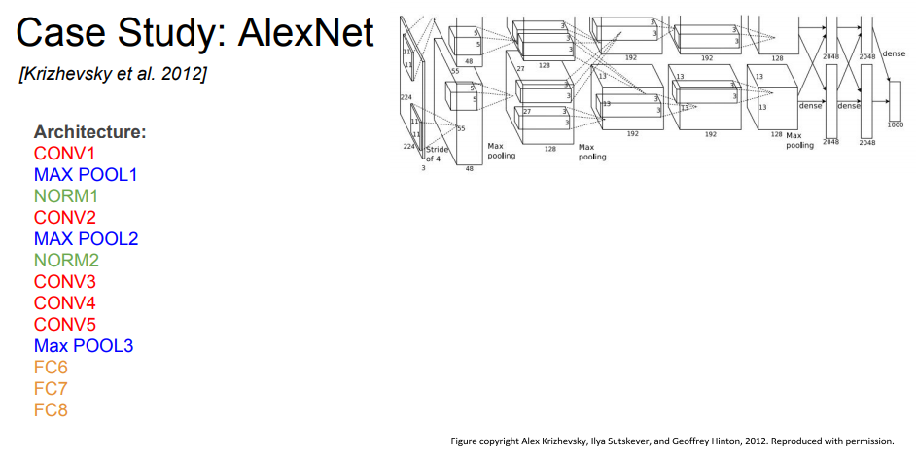
AlexNet

Slide 5
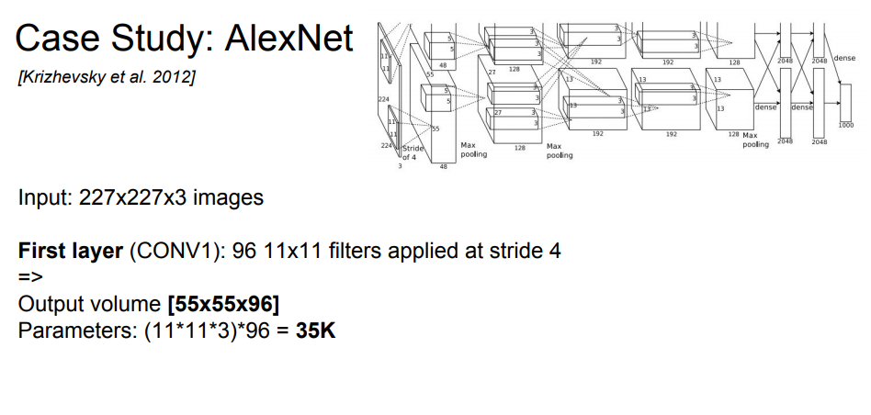
AlexNet

Slide 6
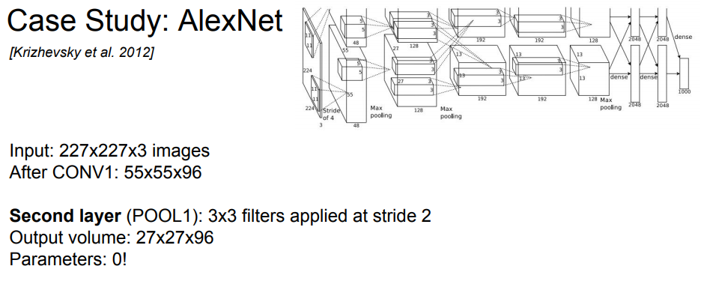
AlexNet

Slide 7
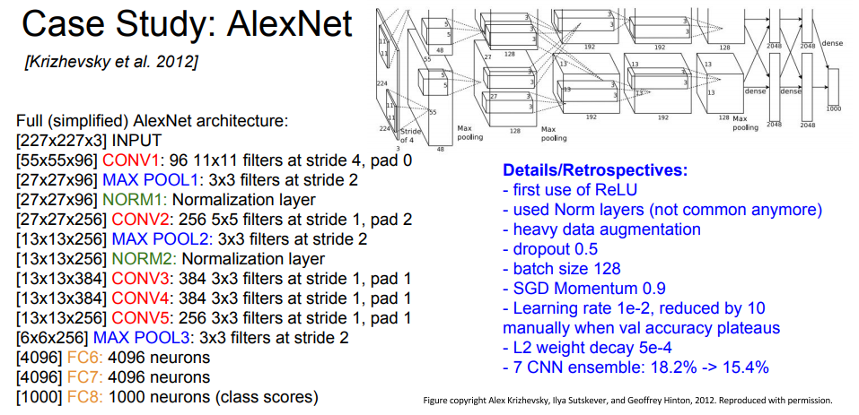
AlexNet

Slide 8
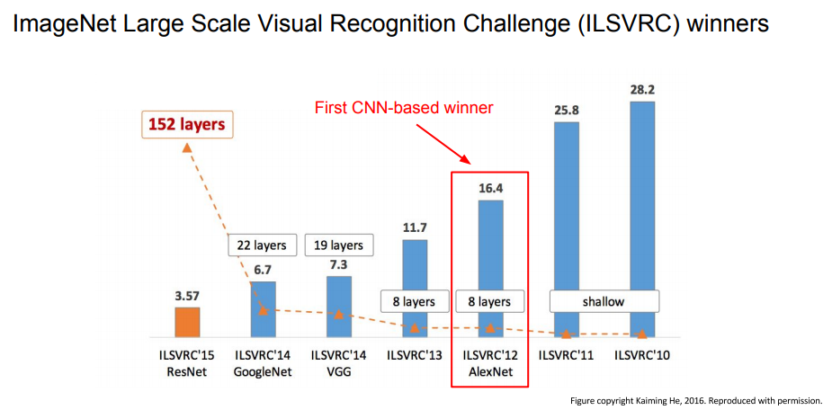
AlexNet

Slide 9
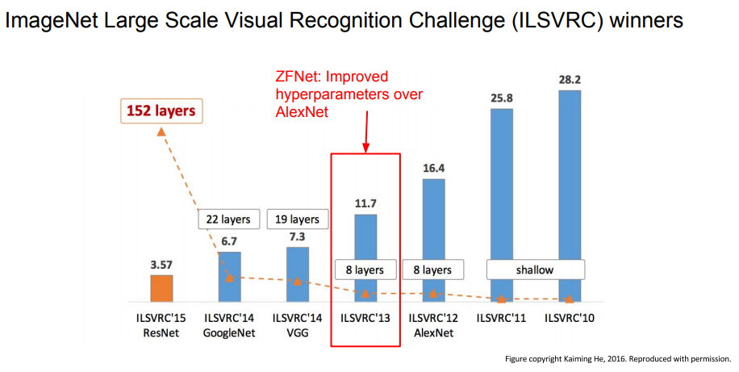
ZFNet

Slide 10
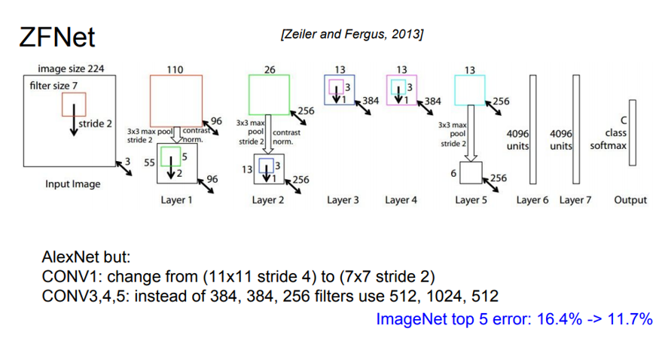
ZFNet

Slide 11
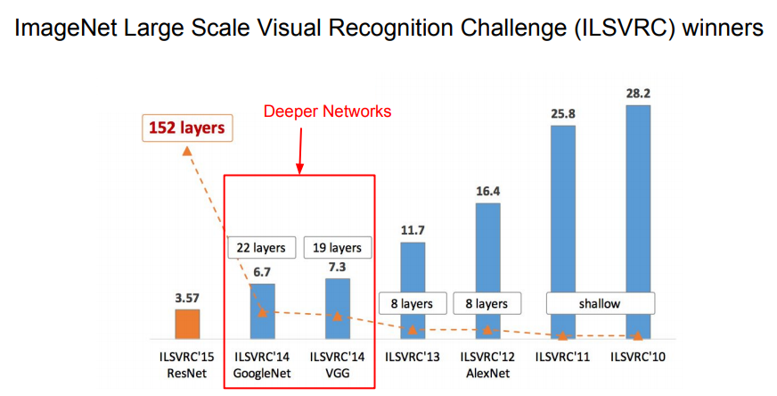
VGG Net and GoogleNet

Slide 12
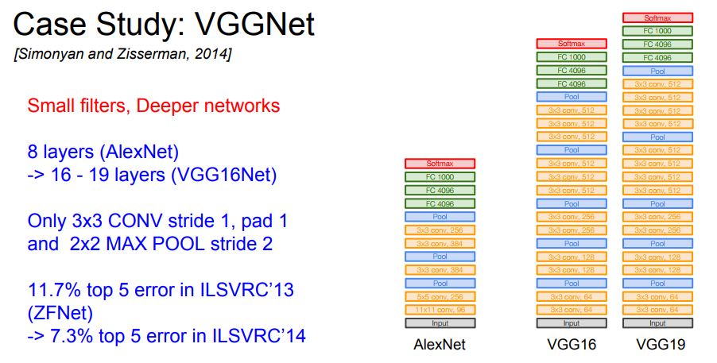
VGGNet

Slide 13
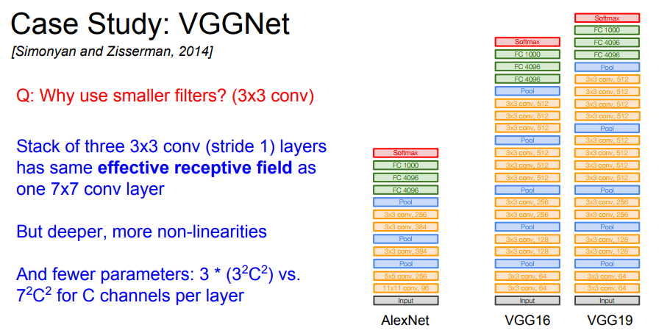
VGGNet

Slide 14
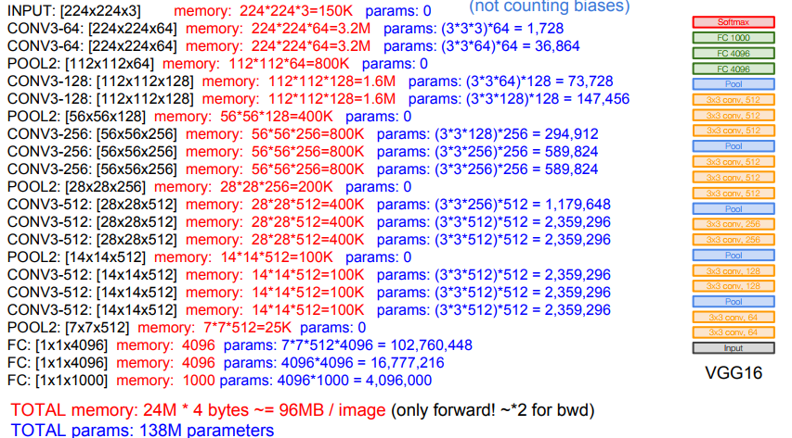
VGGNet

Slide 15
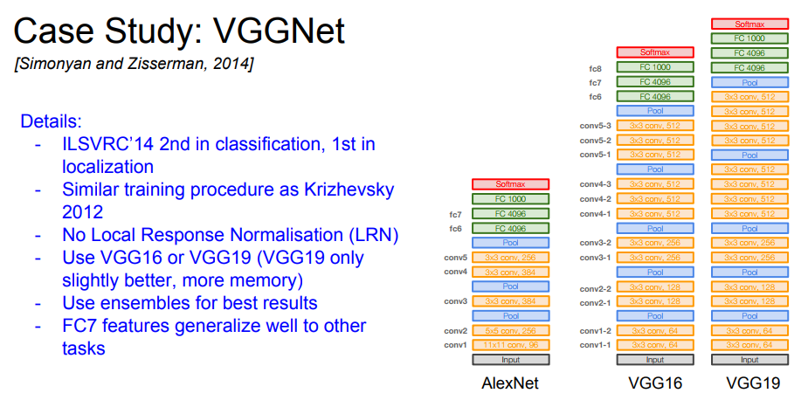
VGGNet

Slide 16
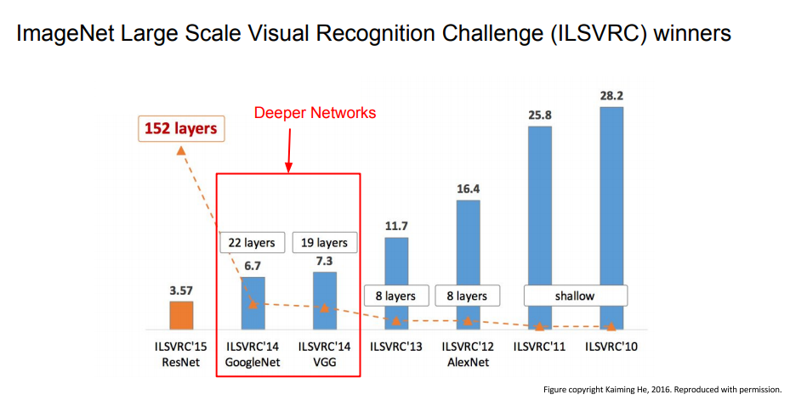
GoogleNet

Slide 17
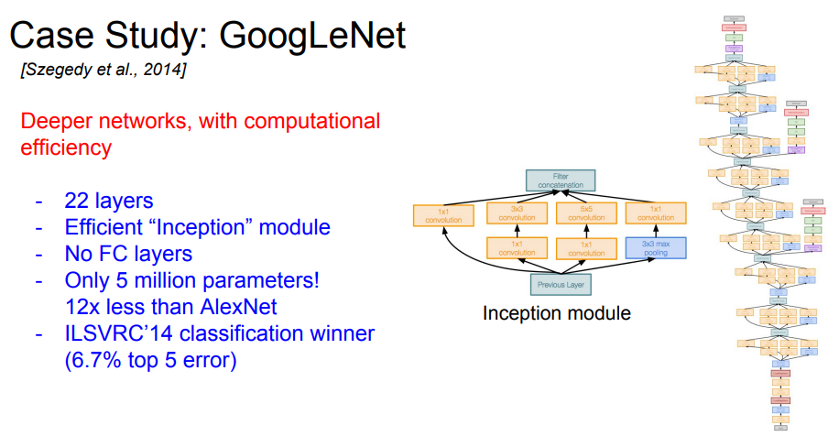
GoogleNet

Slide 18
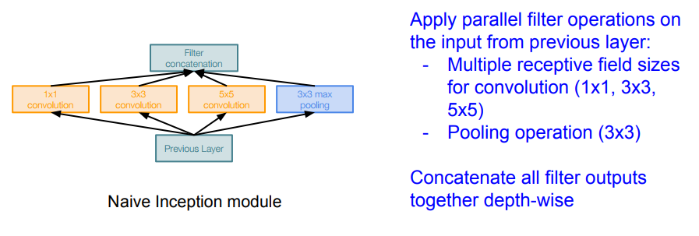
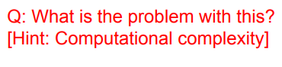
GoogleNet

Slide 19
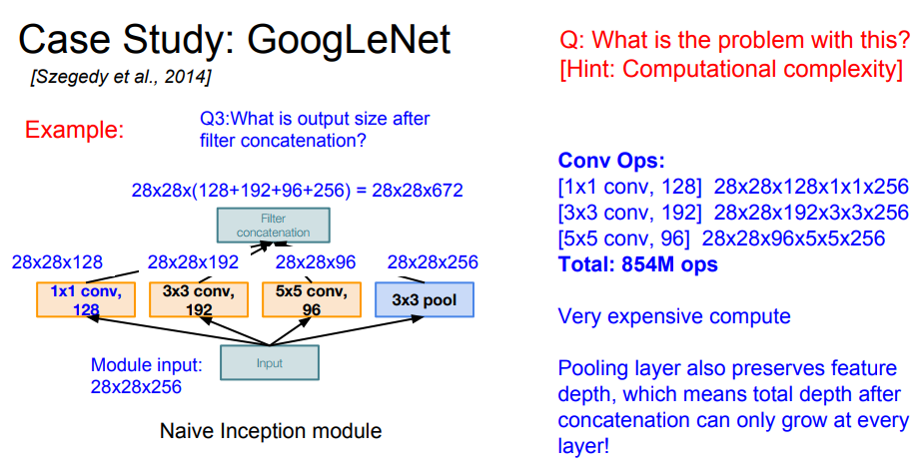
GoogleNet

Slide 20
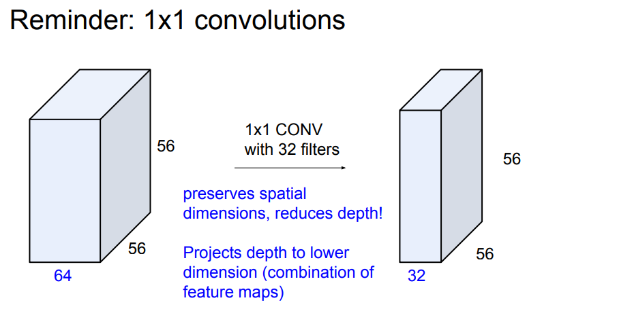
GoogleNet

Slide 21
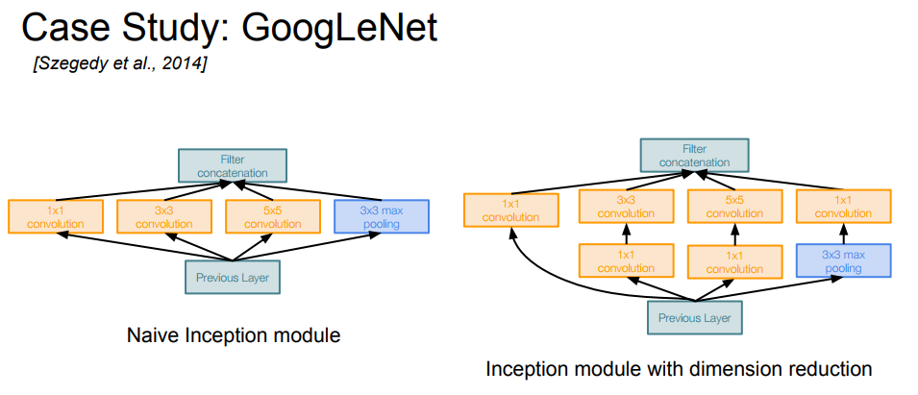
GoogleNet

Slide 22
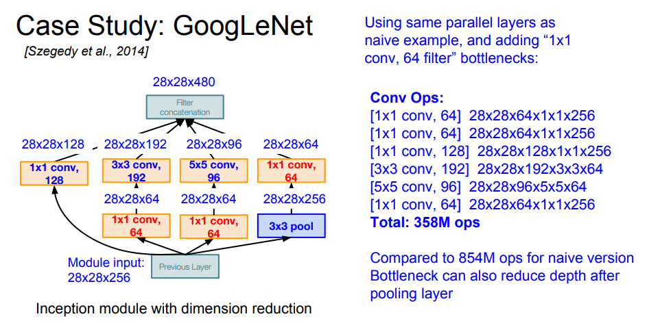
GoogleNet

Slide 23
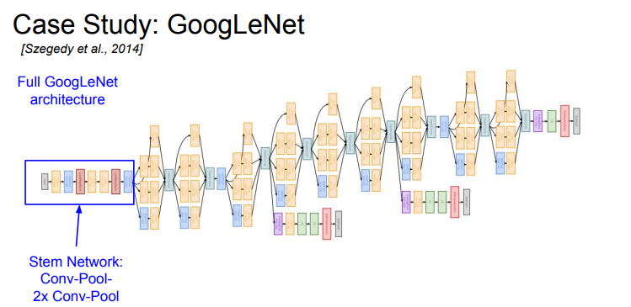
GoogleNet

Slide 24
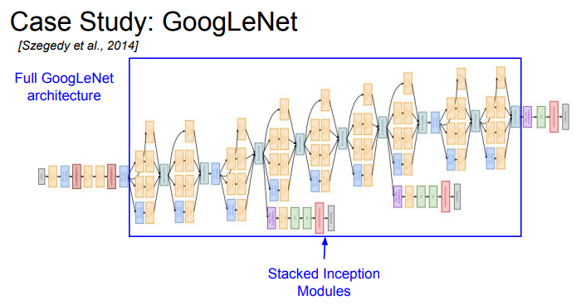
GoogleNet

Slide 25
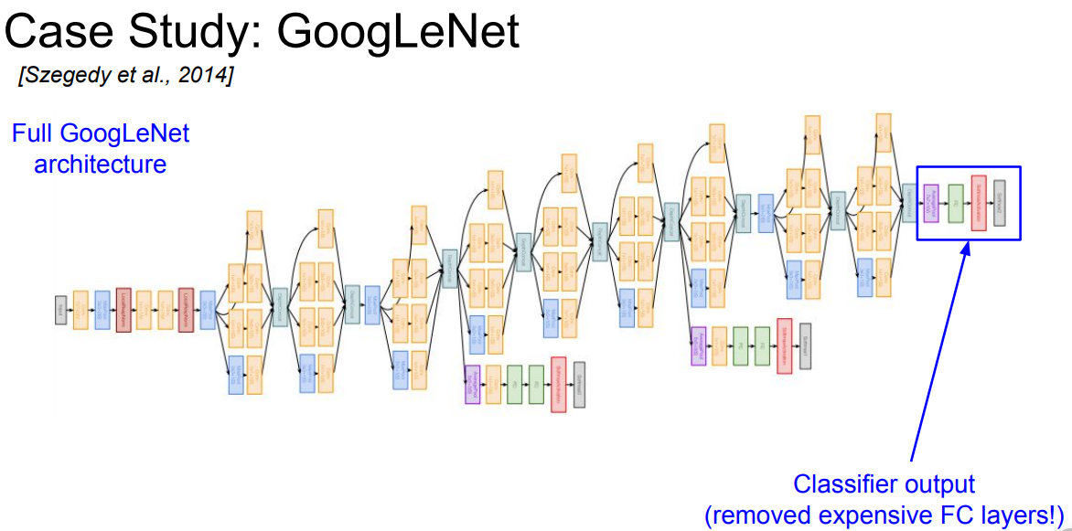
GoogleNet

Slide 26
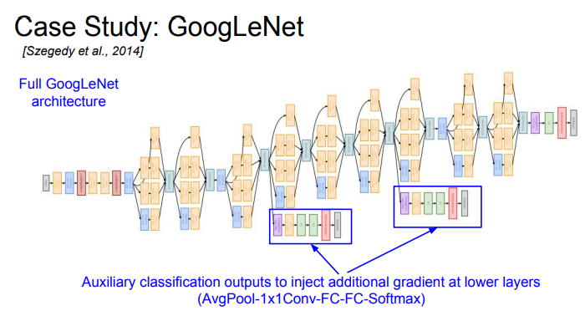
Google Net

Slide 27
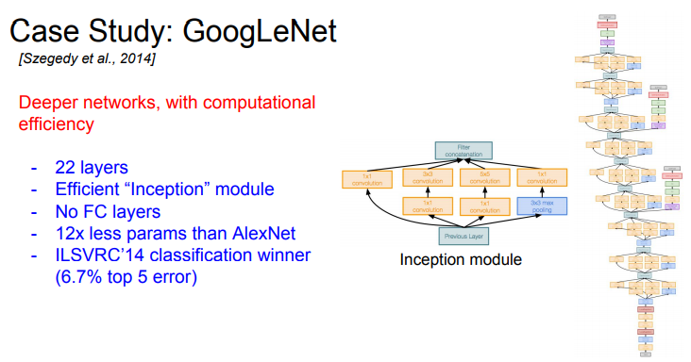
GoogleNet

Slide 28
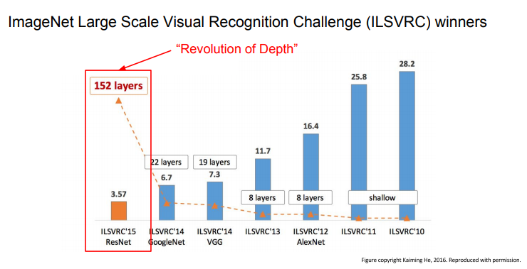
ResNet

Slide 29
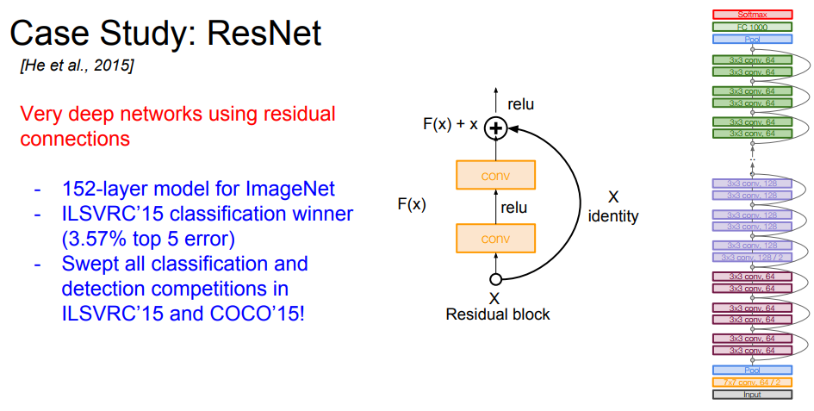
ResNet

Slide 30
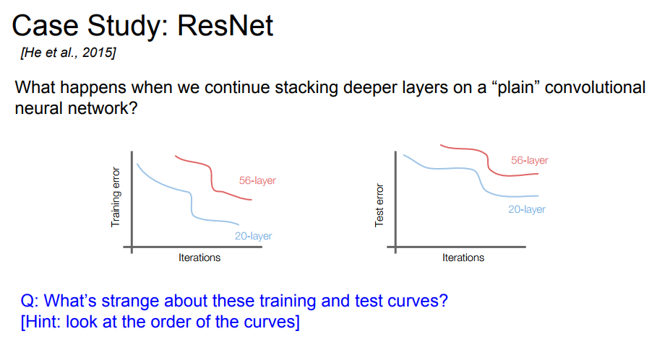
ResNet

Slide 31
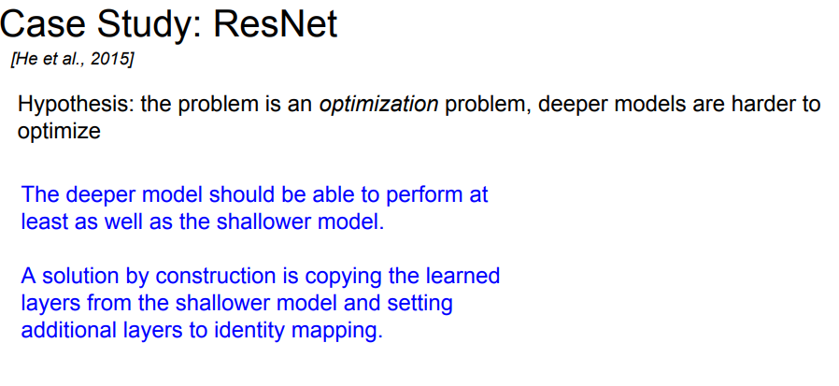
ResNet

Slide 32
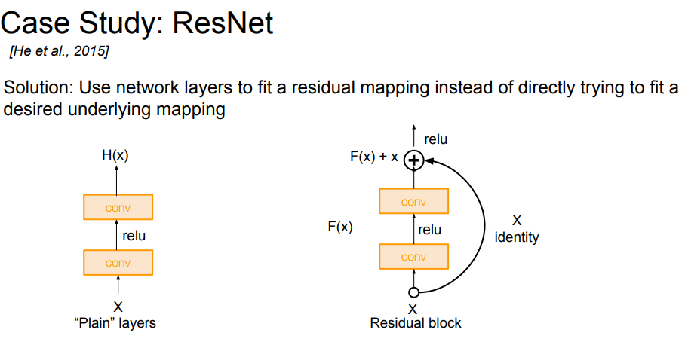
ResNet

Slide 33
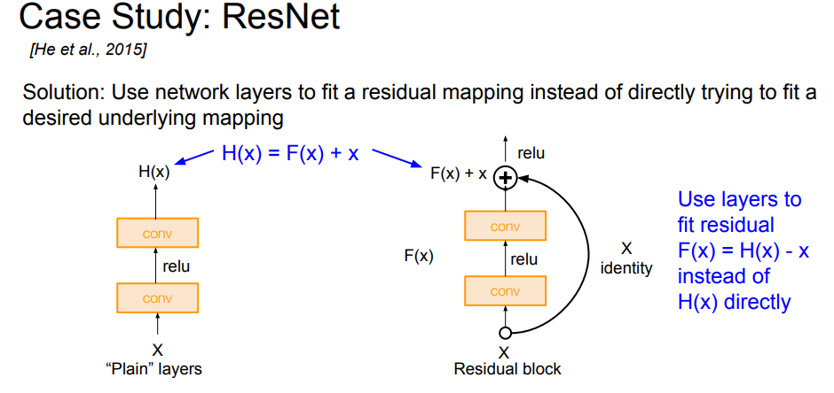
ResNet

Slide 34
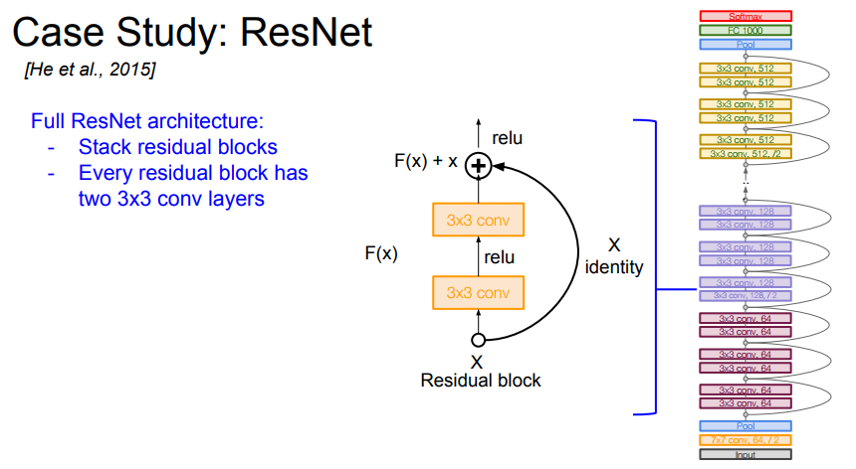
ResNet

Slide 35
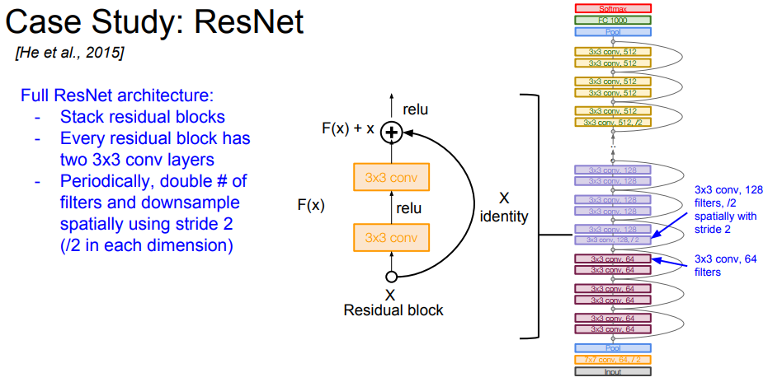
ResNet

Slide 36
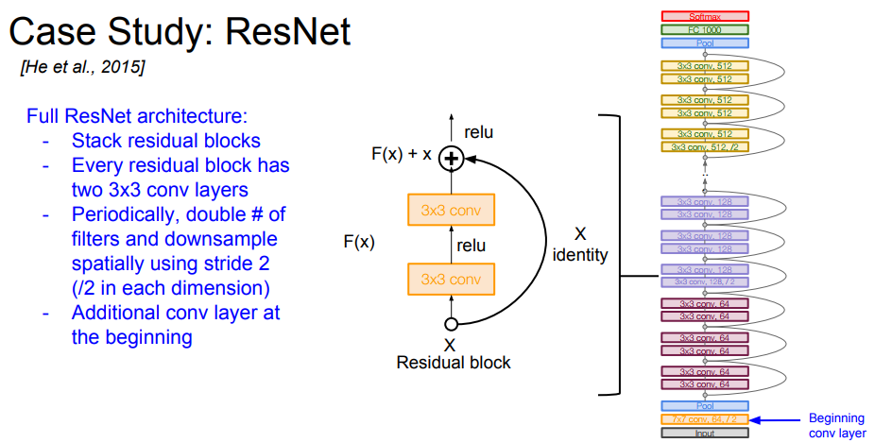
ResNet

Slide 37
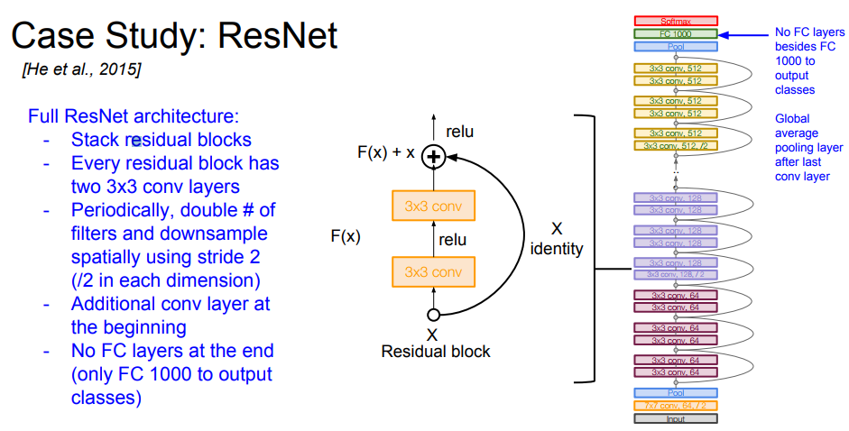

Slide 38
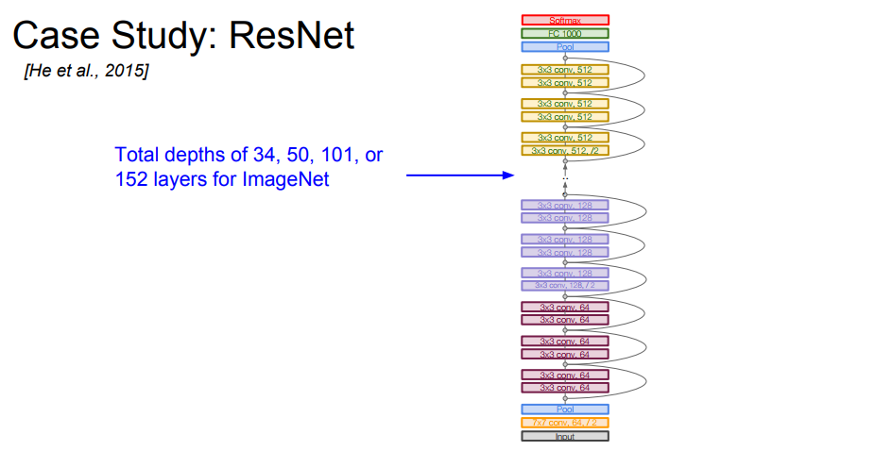
ResNet

Slide 39
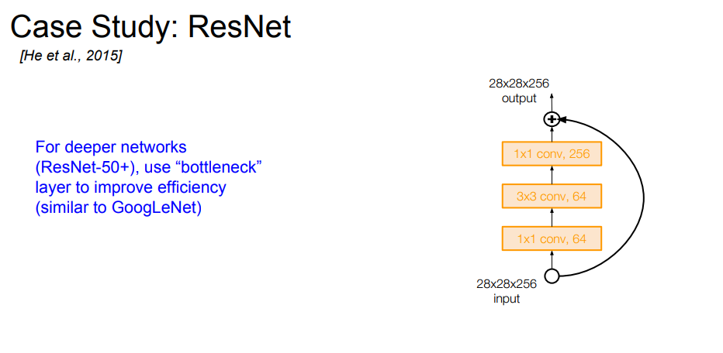
ResNet

Slide 40
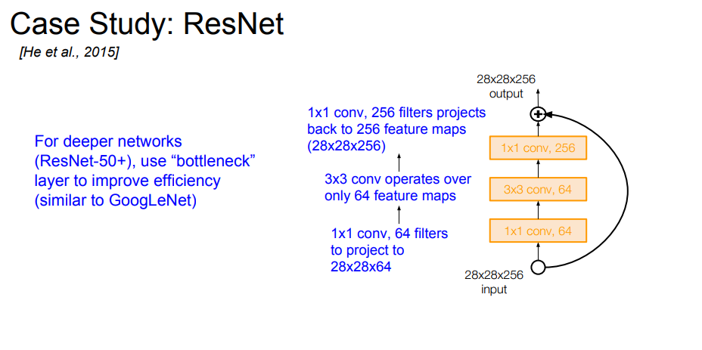
ResNet

Slide 41
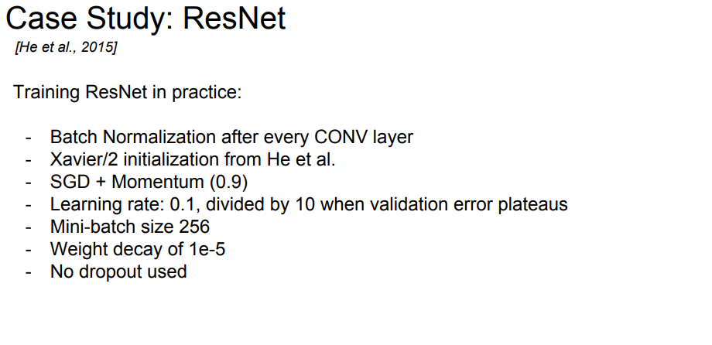
ResNet

Slide 42
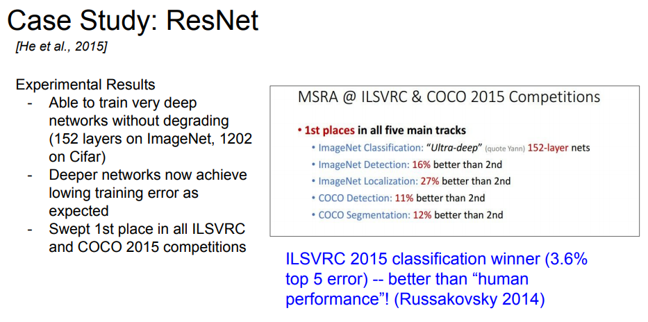
ResNet

Slide 43
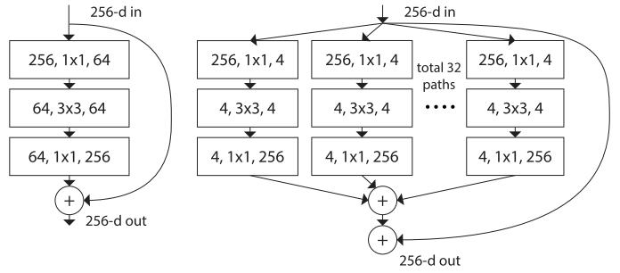
ResNext
ResNeXt

Slide 44
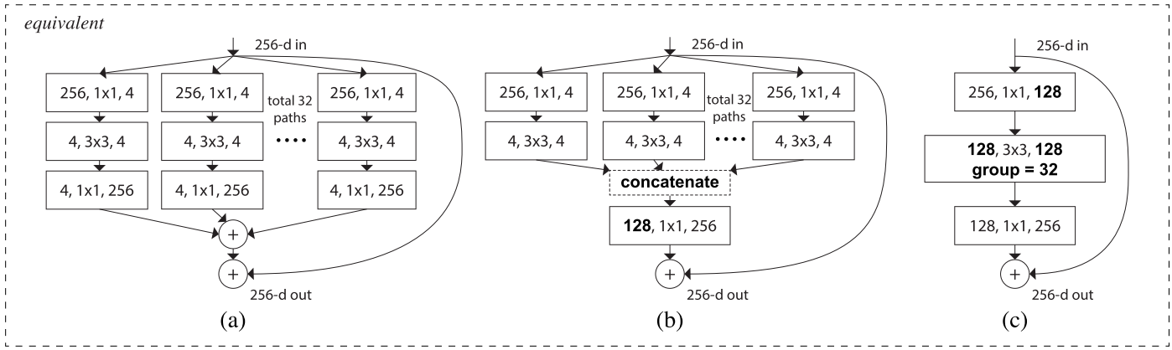
ResNext

Slide 45
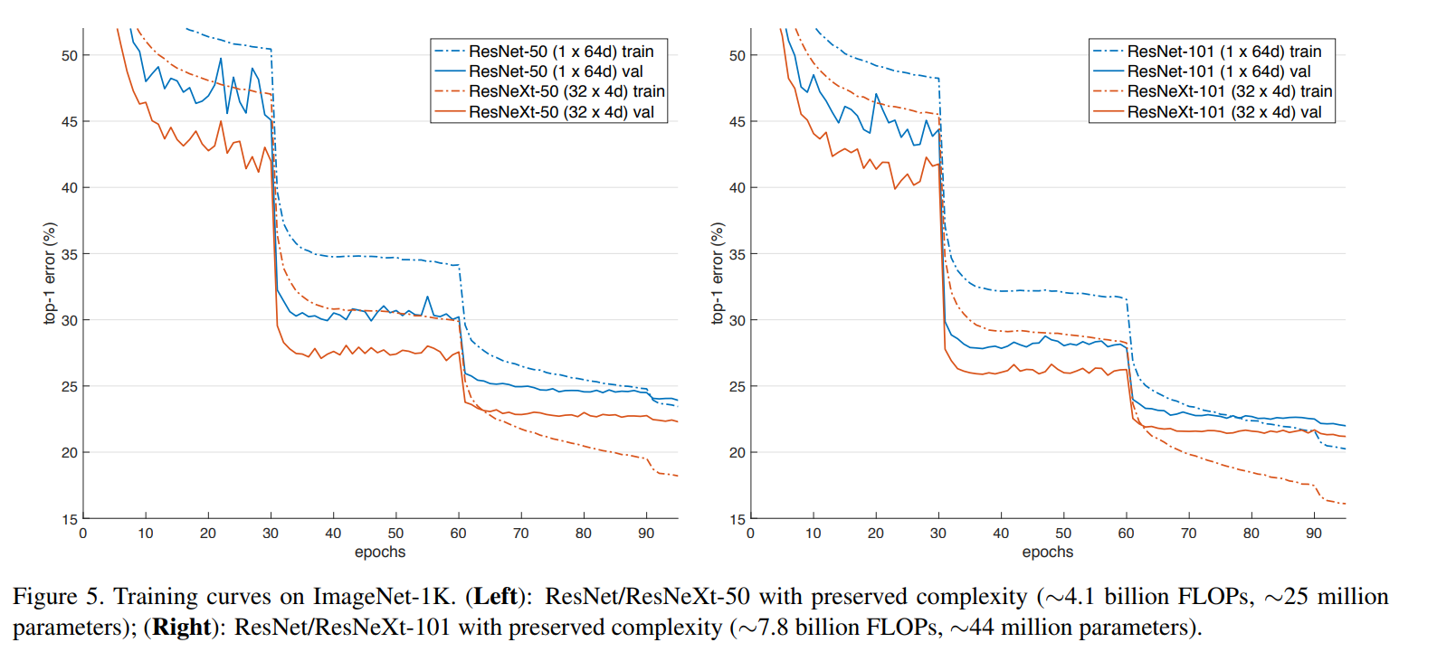
ResNext

Slide 46
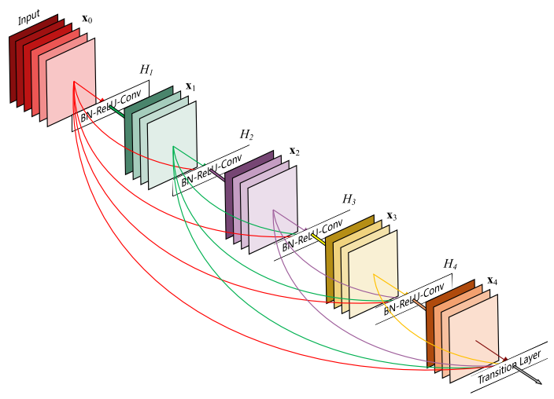
Densely Connected CNN
Huang et al.

Slide 47
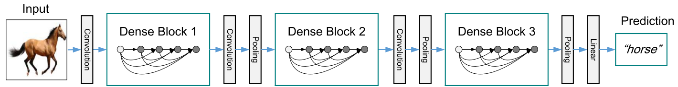
Densely Connected CNN

Slide 48
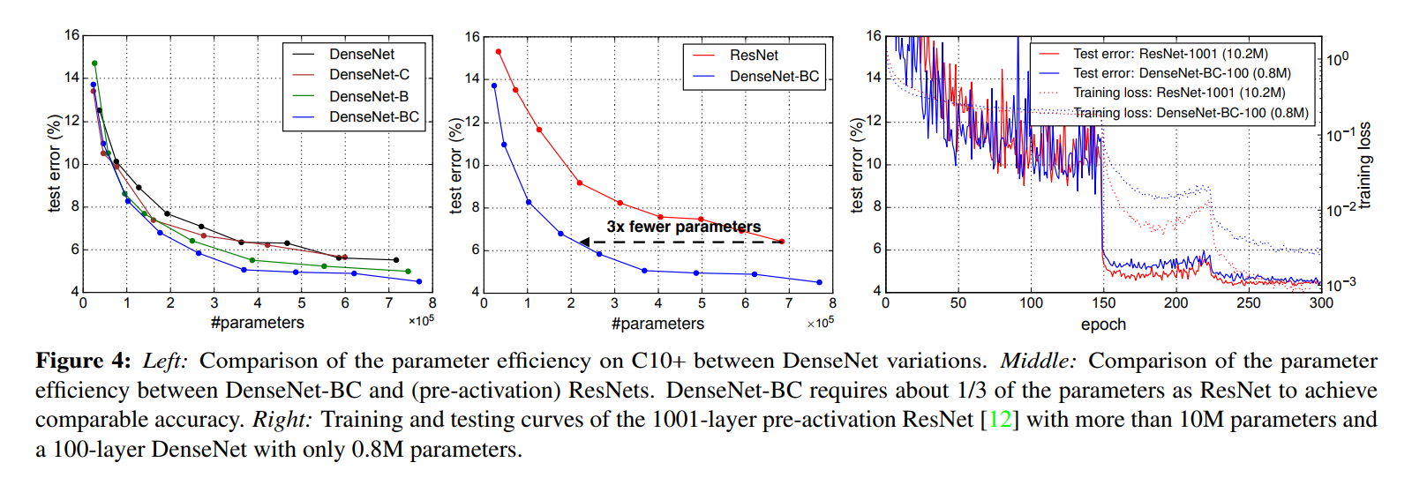
Densely Connected CNN

Slide 49
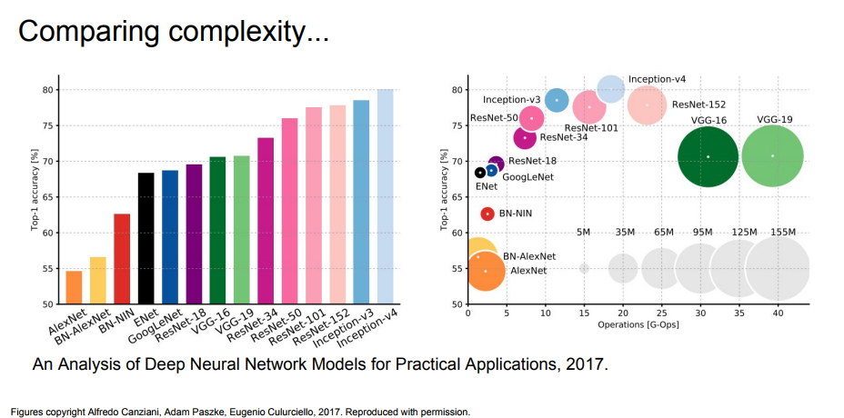
CNN architectures

Slide 50
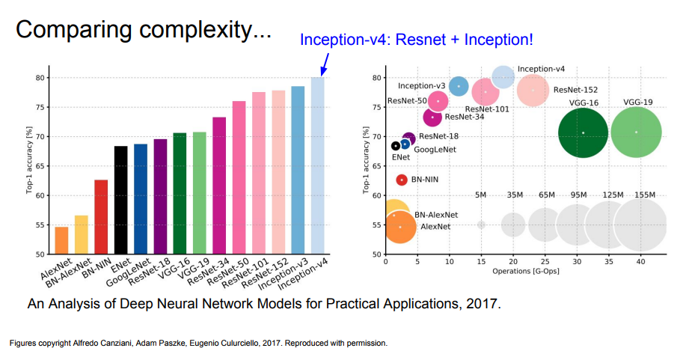
CNN architectures

Slide 51
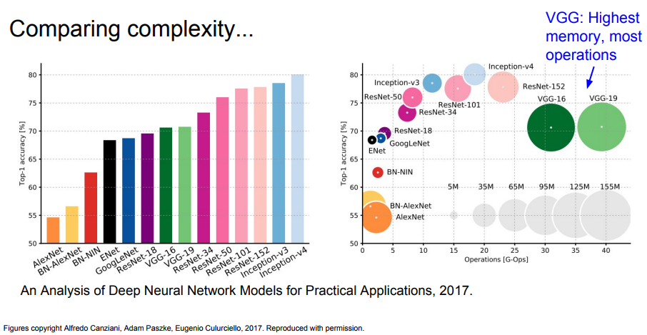
CNN architectures

Slide 52

CNN architectures

Slide 53

CNN architectures

Slide 54

CNN architectures

Slide 55

Data Augmentation

Slide 56

Data Augmentation

Slide 57
Horizontal or vertical Flips.
Random crops and scales.
Color Jitter.
Random mix/combinations of :
Translation
Rotation
Stretching
Shearing
lens distortions,
…

Slide 58
Transfer Learning
You need a lot of a data if you want to train/use CNNs”
Not always true !!!

Slide 59

Transfer Learning

Slide 60

Transfer Learning

